Slide 1
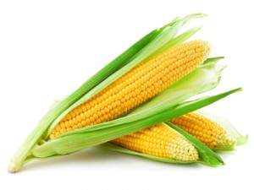
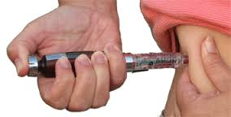
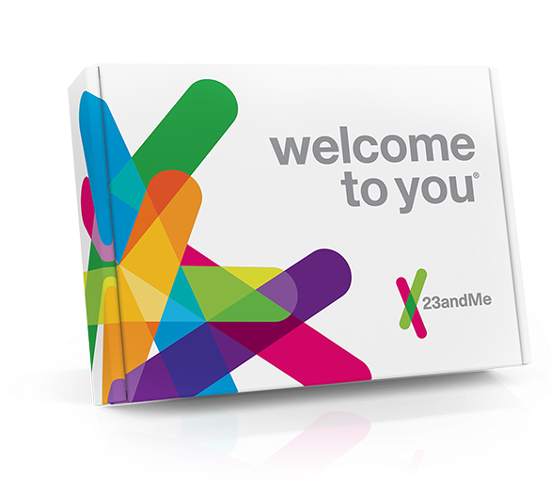
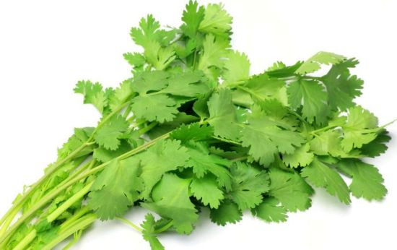
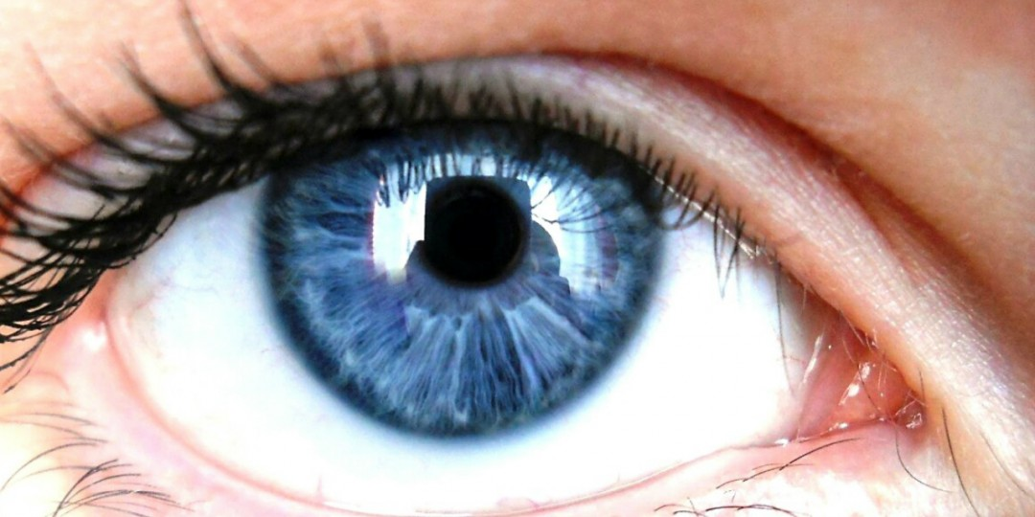
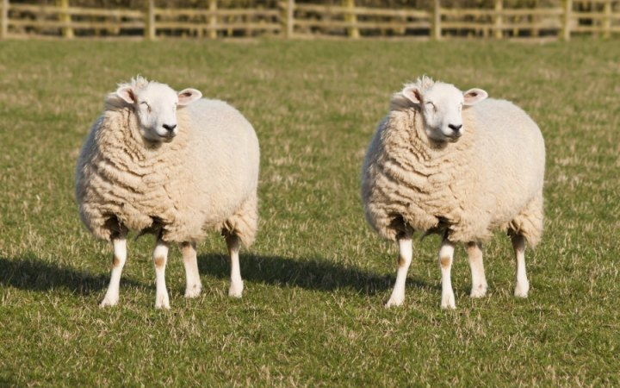
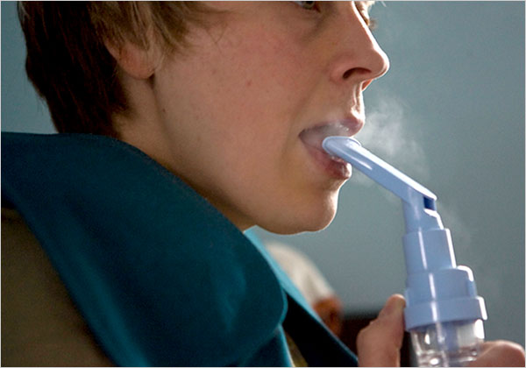


Slide 2
Genetics

Slide 3
DNA
What does DNA stand for?
Where is it found?
What are the building blocks of a DNA molecule? (Clue: bases)
How would you describe the structure?

Slide 4
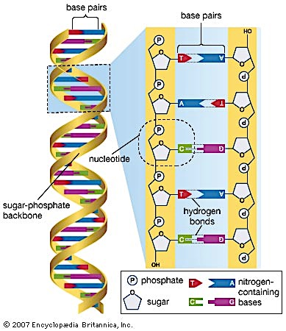

Slide 5
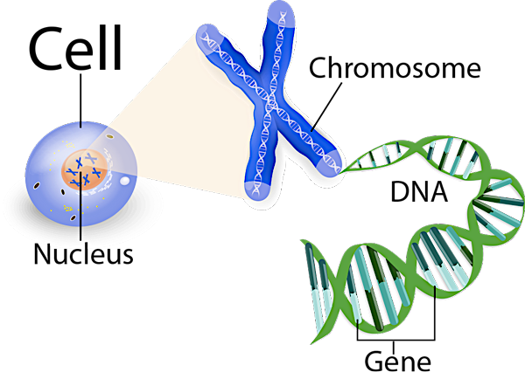
Chromosomes
Found in the nucleus of each cell
The DNA molecule is packaged into thread-like structures called chromosomes
Each chromosome is made up of DNA tightly coiled many times around proteins called histones that support its structure

Slide 6
Genes
Genes are made of segments of DNA i.e. a segment of nucleotides
Genes code for proteins
Enzymes, hormones, antibodies and structural materials of cells are all proteins
haemoglobin
actin and myosin
insulin
amylase

Slide 7
Alleles
What are alleles?
What is a dominant allele? What is a recessive allele? And how is it represented?
What does it mean to be heterozygous?
What about homozygous?

Slide 8
Alleles
alternative forms of a gene that arise by mutation and are found at the same place on a chromosome

Slide 9

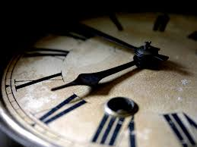
Population
A population is a group of organisms of the same species living together in a particular place at a particular time

Slide 10
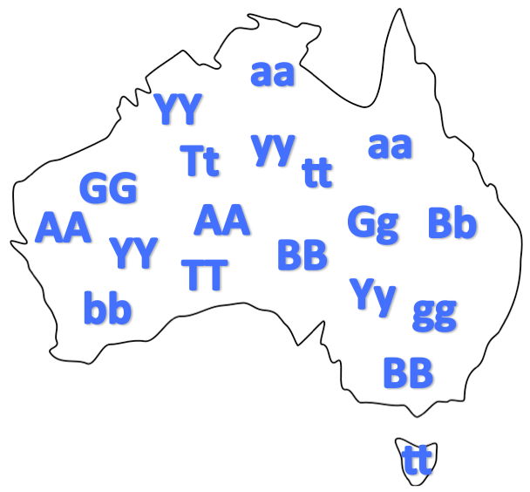
Gene pools
The sum of all alleles of all individuals in a genetic population

Slide 11
Gene pools
The sum of all alleles of all individuals in a genetic population
Therefore, a genetic population is an array of genes, temporarily embodied, but endlessly combining and recombining by the process of sexual reproduction
Gene pools tells us not only the kinds of genes present in the population, but also the way in which these genes are distributed among individuals of the population in question

Slide 12
Gene pools

Slide 13

Mutations
A permanent change in a gene or chromosome leading to a new characteristic in an organism

Slide 14
Mutations
A permanent change in a gene or chromosome leading to a new characteristic in an organism
Mutant organism with a characteristic resulting from a mutation
Two main types of mutations Gene & chromosomal
Can occur randomly or can be induced

Slide 15
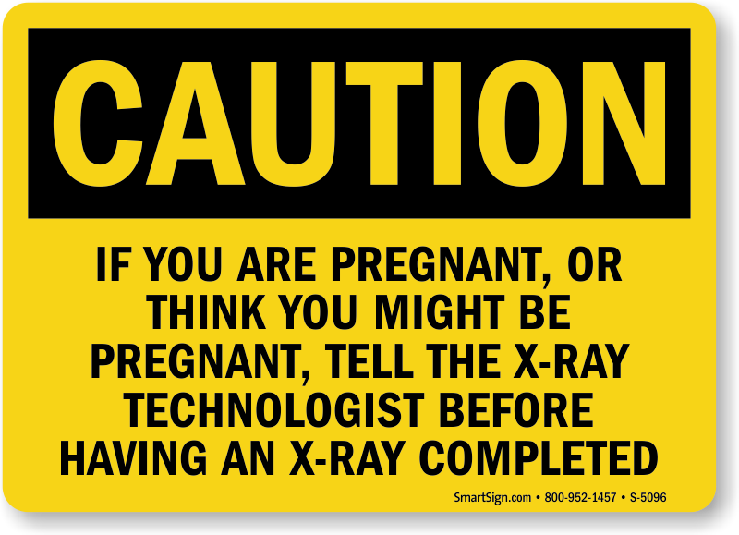
Mutagens
Mutagens/mutagenic agents increase the rate of mutations

Slide 16
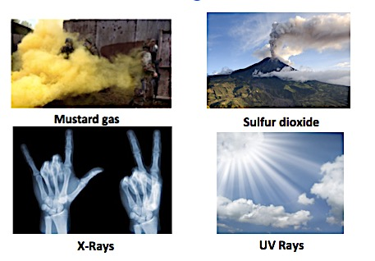
Mutagens

Slide 17
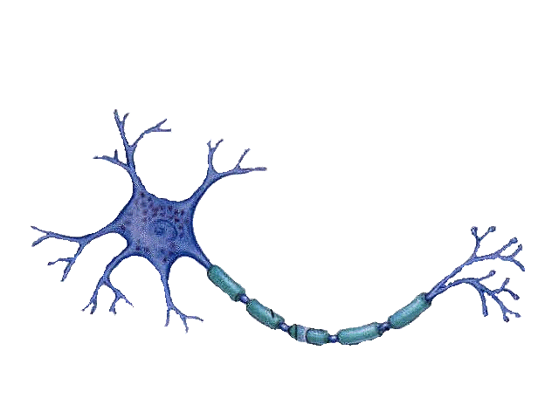
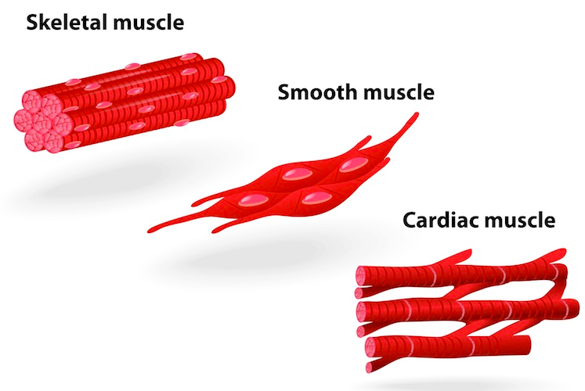
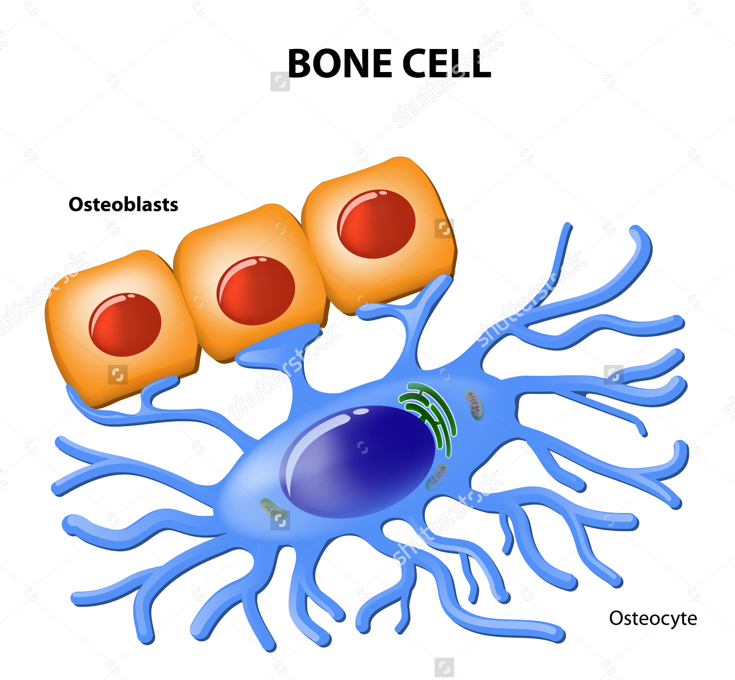
Somatic Mutations
Affects body cells
Only the individual is affected
Involved in cancerous growths

Slide 18
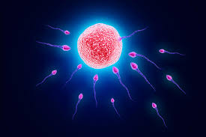
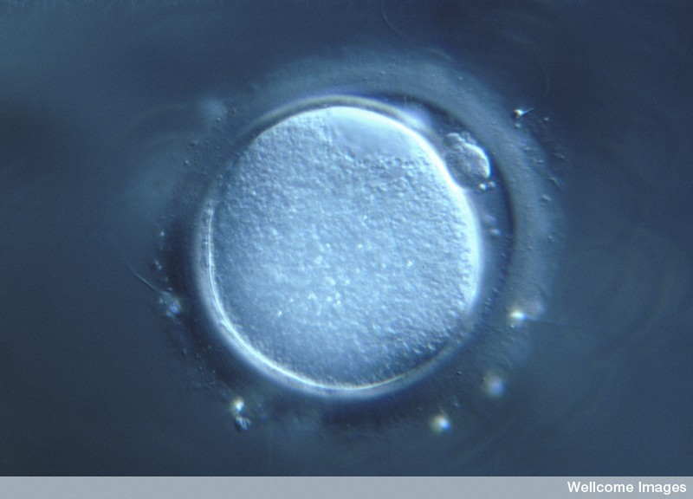
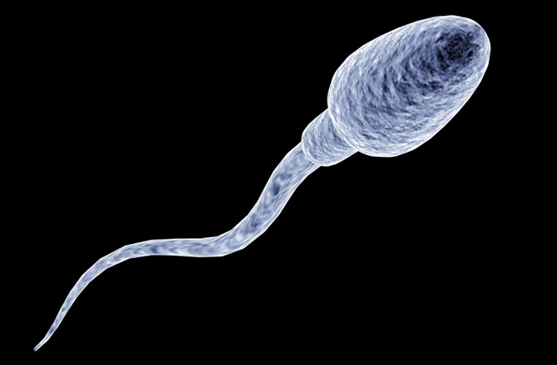
Germline mutations
Mutations occur in gamete cells
Individual normally not affected
Passed on to offspring
Affected embryos are naturally aborted

Slide 19
Somatic vs. Germline mutations

Slide 20
Quick quiz
What is the name given to a group of organisms of the same species living together in a particular place at a particular time?
Define a gene pool
What are the two main types of mutations?
Name one difference between somatic and germline mutations

Slide 21
Quick quiz
Population
The sum of all alleles in a given population
Gene and chromosomal
Somatic individuals affected, occurs in body cells Germline offspring affected, occurs in gametes

